Slide 1
PREDICTION OF HEPATITIS DISEASE USING MACHINE LEARNING ALGORITHMS

Slide 2
TEAM MEMBERS:
Sushma kasoju- 700747358
Mahesh kumar uppu- 700741747
Maheswari pulagam- 700744329
Varna nemula- 700744920

Slide 3
ROLES AND RESPONSIBILITIES:
Mahesh worked on identifying the necessary papers , data selection and basic coding for the project implementation.
Maheswari worked on dataset collection based on the column names required for the project , and tested different values.
Sushma worked on coding for implementing the dataset by importing , traing and testing values.
Varna worked on the code , documentation and presentation of what we have done .

Slide 4
MOTIVATION :
Many Hepatitis carriers are utterly ignorant about their diseases and treatment options. A chronic stage of hepatitis, which is nearly untreatable and so expensive that a poor person could not afford such expenses, is brought on by a lack of adequate medical facilities, poor economic standing, incompetent medical staff, and ignorance about the disease and its prevention.
Many afflicted persons can be saved by early disease prediction and proper diagnosis.
The main goal of the research is to analyze data from a hepatitis dataset using various classification approaches in order to precisely predict the outcome in each example of data.

Slide 5
OBJECTIVE :
Construct a different algorithms model that can be used to predict hepatitis using some real datasets.
Implement the k-NN , Random Forest , support vector machine , Xgboost , decision tree algorithms .
Compare the above algorithms by how accurately they can predict hepatitis disease.
The dataset we will use will be small in practice compared to those in hospitals. However, we are certain that our model will be able to work on datasets of all sizes.

Slide 6
RELATIVE WORK :
Different researches have undergone for the diagnosis and the prediction of diseases using machine learning techniques .
An automatic diagnosis system was proposed by Jiaxin et al. using extreme learning machine on serum indices data of patients to predict the fibrosis stage and inflammatory activity grade of chronic hepatitis C .

Slide 7
PROBLEM STATEMENT :
Given a data set with a number of samples, each of which with a corresponding set of feature values and a classification .
It is found that the performance of the learning methods can become inefficient due to several reasons.
Such as samples may become noisy and unclassifiable or the features may become irrelevant to the classifications.
Therefore a feature selection method should be used to increase the accuracy of prediction of classification.

Slide 8
PROPOSED SOLUTIONS :
The required data set is chosen from UCI repository, considering different clinical cases .
This dataset consists of 156 instances with 20 attributes, one among the same attributes is the class to decide the life expectancy of a hepatitis patient.
Machine learning algorithm such as SVM , KNN , decision tree , random forest , xgboost were applied to the dataset for training and testing.
Comparison was evaluated based on the prediction accuracy of the tool used as well as the mean square error. Lower the mean square error, better the performance.
It has higher accuracy .

Slide 9
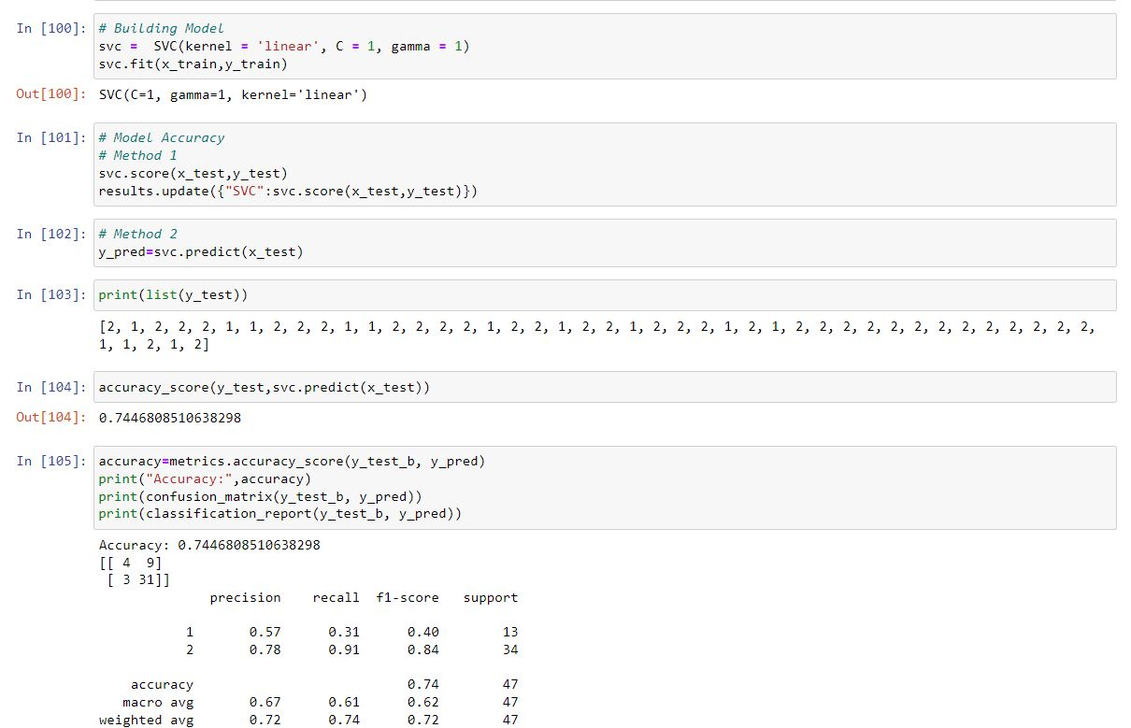
RESULTS : Accuracy of svc:

Slide 10
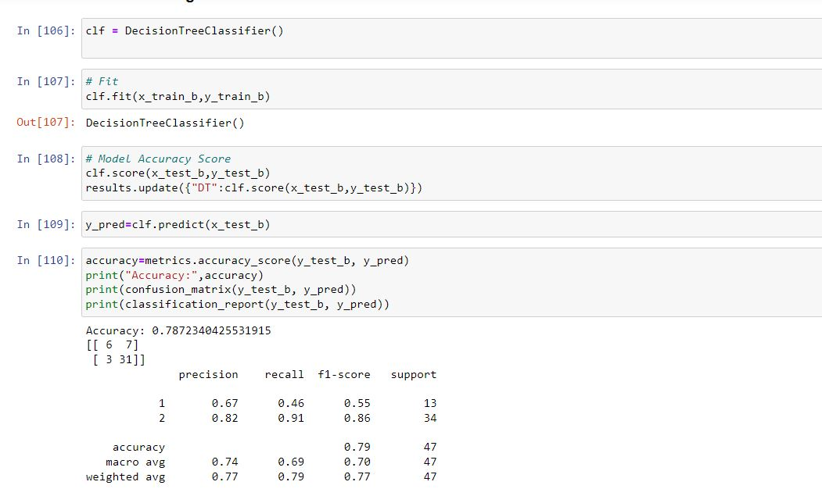
Accuracy of Decision tree:

Slide 11
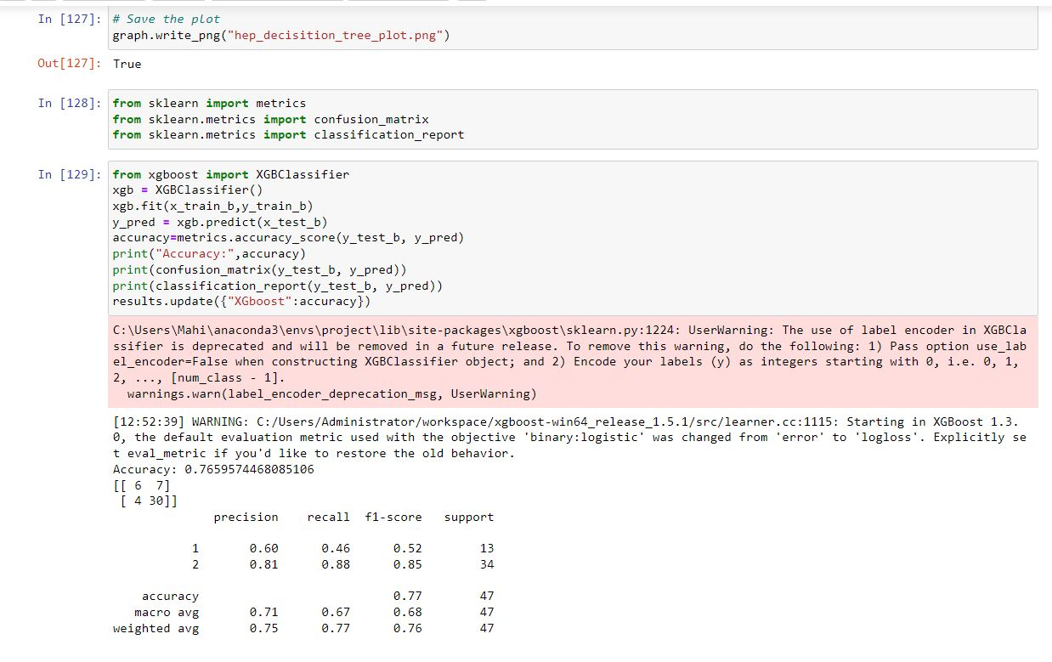
Accuracy of Xgboost:

Slide 12
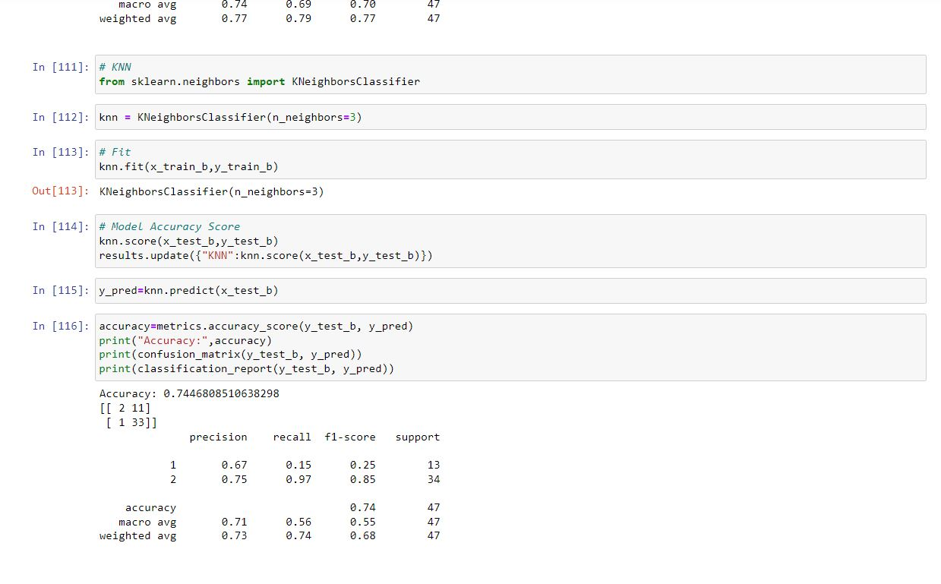
Accuracy of KNN:

Slide 13
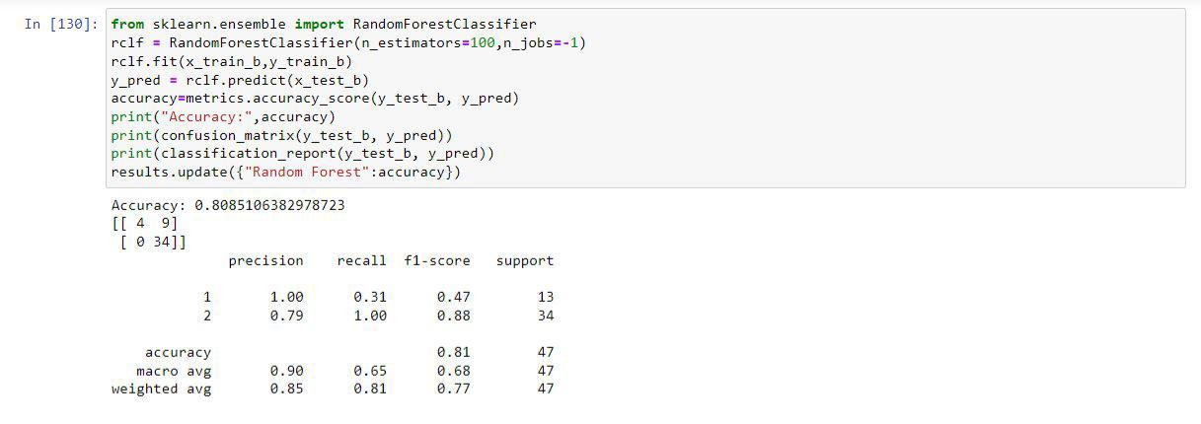
Accuracy of random forest:

Slide 14
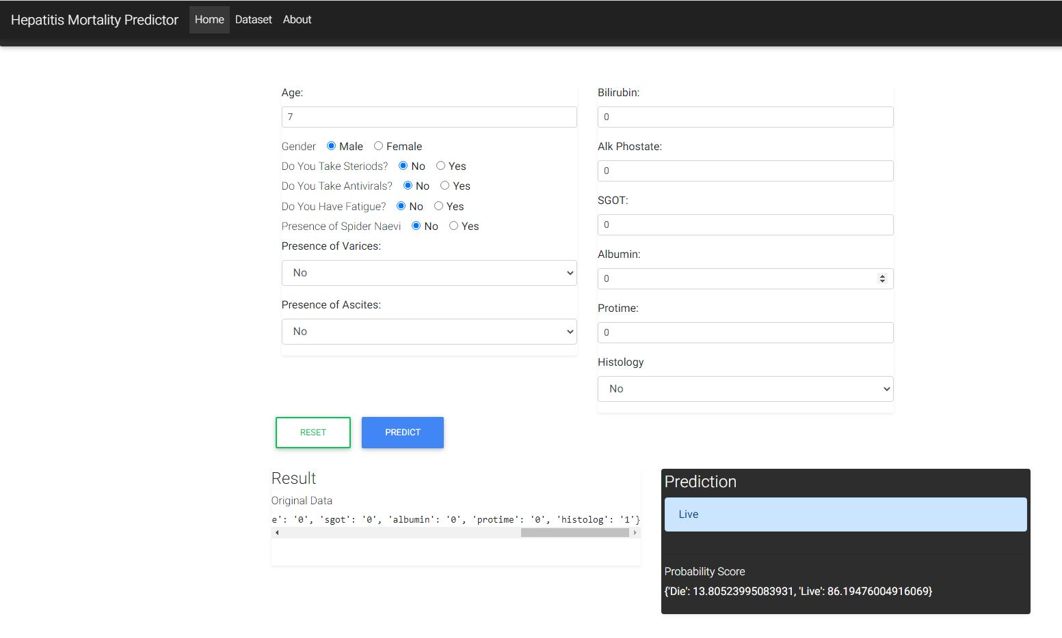

Slide 15
REFERENCES :
M. J. Nayeem, S. Rana, F. Alam and M. A. Rahman, “Prediction of Hepatitis Disease Using K-Nearest Neighbors, Naïve Bayes, Support Vector Machine, Multi-Layer Perceptron and Random Forest,” 2021 International Conference on Information and Communication Technology for Sustainable Development (ICICT4SD), Dhaka, Bangladesh, 2021, pp. 280-284
V. K. Yarasuri, G. K. Indukuri and A. K. Nair, “Prediction of Hepatitis Disease Using Machine Learning Technique,” 2019 Third International conference on I-SMAC (IoT in Social, Mobile, Analytics and Cloud) (I-SMAC), Palladam, India, 2019, pp. 265-26
G. V. Nivaan and A. W. R. Emanuel, “Analytic Predictive of Hepatitis using The Regression Logic Algorithm,” 2020 3rd International Seminar on Research of Information Technology and Intelligent Systems (ISRITI), Yogyakarta, Indonesia, 2020, pp. 106- 110

